Slide 1
Lecture 3 Device Interfacing 1
Commonly used hardware I/O mechanisms and techniques:
Memory mapped I/O
Serial communication:
How it works and important concepts
Standard protocols

Slide 2
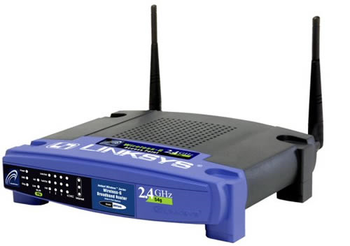
Context of this lecture:
How are devices connected to a microprocessor?
How does software communicate with a device?
How does a device make the CPU aware that it has new information?
How do we do this efficiently to ensure real-time constraints are met?
8MB RAM
8MB RAM
Flash memory
4 LAN ports
WAN port
CPU
Ethernet controller
WLAN

Slide 3
In a general-purpose programming environment (Desktop), direct hardware/device access is usually prohibited by the Operating System (OS). Why?
Safety
Security
With embedded systems we can usually have direct access to hardware/devices
For embedded systems, an OS may not exist! Or for a real-time embedded system a multitasking RTOS is adopted.

Slide 4
Introduction – Serial Communication
What determines how we decide to send data?
Data rate
Data format
Amount of data
Cost
How would these factors relate to:
A flight control system in a military aircraft e.g. Eurofigther Typhoon
A digital force gauge used to measure the mass of the load in a washing machine

Slide 5
Serial I/O
A single wire carries a stream of digital data signals (voltages)
Clearly, only one signal on the wire at one time
Simple physical connections
Used for microprocessor ⬄ (microprocessor or device communication)
Simple networking
Low cost
Requires a method to convert bytes to bits and vice versa

Slide 6
Parallel I/O
Multiple wires carry parallel digital data signals (voltages)
Individual bits signalled simultaneously
Characterised by a wider data bus
Bus width increases cost of interface and complicates the physical design and connections
Parallel communications can suffer crosstalk (adjacent line interference)
Simple connection to data bus since no bit → byte conversion

Slide 7
UART – Universal Asynchronous Receiver/Transmitter
USART – Universal Synchronous/Asynchronous Receiver/Transmitter
These modules provide the mechanism to send/receive data words as a string of individual bits for serial communication

Slide 8
Synchronous Serial Transmission
Sender and receiver synchronise themselves for communication using a shared clock signal.
Data sent relative to this shared clock signal
If NO data is to be sent, filler data is sent.
Complete in the lecture

Slide 9
Asynchronous Serial Transmission
No shared clock signal to synchronise Tx and Rx - transmission parameters are agreed in advance.
Bits sent at a uniform rate and no data fillers required.
Uses a Frame as its data packet format.

Slide 10
Data transfer rates
Bit time
The constant time between sequential bit transmissions
Baud Rate
Rate at which bits are communicated (transmitted and received). Tx and Rx clearly need the same baud rate:
Baud Rate = 1 / Bit time
Actual Bandwidth
Rate of communication of user data only
Bandwidth = Baud Rate × (User data per frame/ Total data per frame)
Start Bit
8 Data Bits
Stop Bit

Slide 11

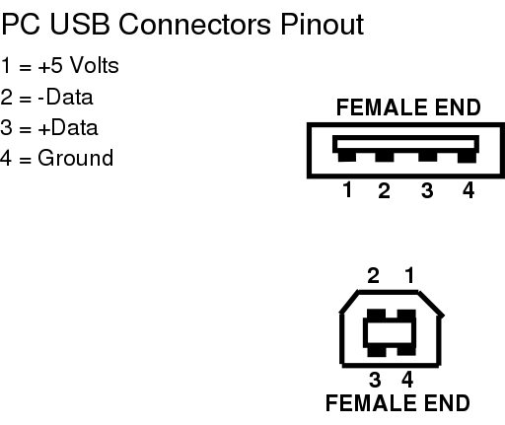
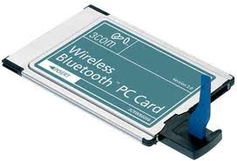
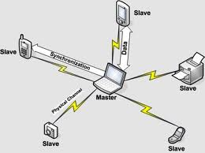
Types of serial data bus
Embedded
USB (Universal Serial Bus)
Bluetooth

Slide 12
Examples of Embedded Serial Buses
Serial I/O buses commonly found in Embedded Systems (from Computer Architecture, 3rd Edition, Hennessy & Patterson)
What about the STM32F407? STM32F - Datasheet

Slide 13
Summary – Serial Communication
Serial I/O transmits data bits sequentially rather than in parallel
Simplified connections and wiring
Asynchronous/Synchronous
Serial I/O based on UART / USART, RS232, USB and bluetooth
Hardware devices often attached to embedded systems using standard protocols, such as I²C or SPI.

Slide 14
Introduction - Hardware I/O Mechanisms
How does a CPU know which I/O device to communicate with?
I/O addressing
When does communication happen?
Polling and Interrupts are low level device I/O methods → efficient
I/O devices have status, data and control registers
What happens when a large amount of data needs to be sent/received?
Direct Memory access

Slide 15
Memory-Mapped I/O
In memory mapped I/O:
Portions of a machines address space is assigned to I/O devices
I/O devices are connected to a processor in a similar way to memory.
Reads and Writes to those mapped addresses may cause data transfer, or pass a command to a device.
For most embedded system microprocessors/microcontrollers each I/O port is memory mapped.
→ STM32F – Datasheet page 70-74

Slide 16
By manipulating registers (mapped into system memory) we can control a device.
The data bus maybe composed of data, status and control information → separate registers in the memory map for data, status and control
Complete in the lecture

Slide 17
The device connected on the I/O bus will also have a mixture of status, control and data registers.
To communicate correctly with this device we need to know the internal address of these registers.
LIS3DSH - Data Sheet
We then proceed to send a sequence of bytes which is usually as follows:
Part of the address is usually reserved to signal whether the device wishes to read or write to the register.
I2C:
Write data from the CPU to the device
The address of the register in the device is sent on the bus from the CPU to device.
The new data for the register is sent on the bus from the CPU to device
Read data from the device to the CPU
The address of the register in the device is sent on the bus from the CPU to device
The data in the register on the device is sent from the device to the CPU on the bus.

Slide 18
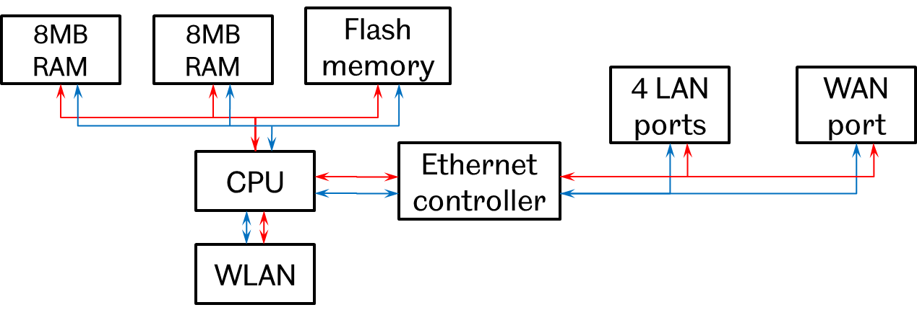
What about a separate address bus?
Address Bus
Data Bus
8MB RAM
8MB RAM
Flash memory
4 LAN ports
WAN port
CPU
Ethernet controller
WLAN

Slide 19
Summary
Device Interface Addressing – memory mapped I/O
Hardware I/O techniques
Additional reading document – Sensors, Actuators and ADC/DAC.

Slide 20
Demo 3
The STM32F4 Discovery Accelerometer and SPI interface
Part A
Understanding how the STM32F407 and LIS3DSH are connected.
Configuring the SPI interface on the STM32F407
Reading data from the LIS3DSH
Configuring the LIS3DSH
Part B
Declaring, defining and calling functions.

Slide 21
Understanding how the STM32F407 and LIS3DSH are connected
Refer to the STM32F4 Discovery user manual:
STM32F407Discovery - User Manual
Serial communication using the SPI protocol (page 17).
Connected through GPIO A and E (pages 21-33).

Slide 22
Configuring the SPI interface on the STM32F407
First understand the characteristics of the SPI interface:
STM32F - Processor Reference manual (page 859 onwards)
LIS3DSH - Data Sheet (page 24-28)
SCL connected to PA5 on the STM32F407 is the clock line
SDO connected to PA6 on the STM32F407 is the output data line
SDI connected to PA7 on the STM32F407 is the input data line
CS connected to PE3 on the STM32F407 is the serial port enable line

Slide 23
Configuring the SPI interface on the STM32F407
The LIS3DSH acts as a slave device, thus we need to set the STM32F407 as the master and use it to initiate communication.
There are 2 data lines allowing full-duplex communication.
The data is sent in 8-bit packets (plus 8-bits for the device address)
The clock remains high during idle and the data line is sampled on the rising edge of the clock line, which is the second clock transition (the first is 1 to 0 and then the second is 0 to 1) after idle.
The address/data is sent most significant bit (MSB) first.
The clock needs to operate at a maximum frequency of 10MHz.

Slide 24
Configuring the SPI interface on the STM32F407
Write the C code to configure the SPI as required.
Use the data structures and functions defined as part of the HAL drivers and information on the processor registers in the STM32F - Processor Reference manual.
We will refer to the code in Assessed Lab 2 – Part A to see how this is done (steps 3-5).
Note that both the SPI and alternate function for the required GPIO pins that the SPI uses needs to be configured.

Slide 25
Reading data from the LIS3DSH
Write the C code to read data from the LIS3DSH using the SPI.
Use the data structures and functions defined as part of the HAL drivers to read the register values.
Toggle the CS line of the SPI low.
First, use the transmit function to send the address of the register that you want to read (make sure that the read/write bit in the address is set to read).
Second, use the receive function to get the contents of the register into a variable in your program.
Toggle the CS line of the SPI high.
We will refer to the code in Assessed Lab 2 – Part A to see how this is done (step 6).

Slide 26
Configuring the LIS3DSH
Consult the LIS3DSH register information provided in sections 7 and 8 of the LIS3DSH - Data Sheet to determine what registers and values are required for your desired operation.
Use the data structures and functions defined as part of the HAL drivers to set the LIS3DSH register values.
Toggle the CS line of the SPI low.
First use the transmit function to send the address of the register that you want to write to(make sure that the read/write bit in the address is set to write).
Second use the another transmit function to send the new contents of the register to the LIS3DSH.
Toggle the CS line of the SPI high.
This is in Part B of assessed lab 2 – the assessed part.

Slide 27
Functions
In previous labs you have written all of you executable code in main().
Functions are a common way of streamlining your code when the same code is re-used, or to enhance readability.
We will use the previously created “my_header” files to house our functions.

Slide 28
Functions
There are several steps to creating and using functions:
Declare the function (name, input data types, output data types) in “my_header.h”.
Define the contents of the function (i.e. what it will do) in “my_header.c”.
Call the function in either main() or another defined function.

Slide 29
Functions
We will follow the steps in Part A of the RTOS Lab to re-write our very first program (a simple blinky) to use functions.
We will declare, define and call two functions:
Initialise_LED : This function will be used to initialise the LEDs as required (turn on the required GPIO clock and set the required GPIO pins to output).
Blink_LED : This function will be used to contain our main executable code that blinks the LED on and off at 1 second intervals.

